Slide 1
Topic Modeling
Suchartee Kitisopakul

Slide 2
Agenda
Problem
Proposed Solution
Methodology
Results & Discussion
Conclusion
Future Work

Slide 3
Problem

Slide 4

Problem
News is one of knowledge sources
Valuable data in business
Phatra Securities
Time
People

Slide 5
Proposed Solution

Slide 6
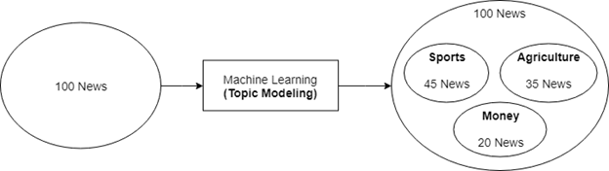
Proposed Solution
Unsupervised Machine Learning
Topic modeling
Latent topics
Clustering
Cluster member
Topic Modeling
Overlapped members

Slide 7
Methodology

Slide 8
Methodology: Data Preparation
HuffPost News
200,000 → 35,056 news
Data Preprocessing
Tokenizing
Stemming
Removing Stopwords
Removing Proper Nouns
TF-IDF
Bi-Gram
~20,000 corpus

Slide 9
Methodology: Implementation
Latent Dirichlet Allocation (LDA)
Statistically calculates the probability distribution among documents
Hidden theme
9 models
2 - 10 topics
Model_0 to Model_8

Slide 10
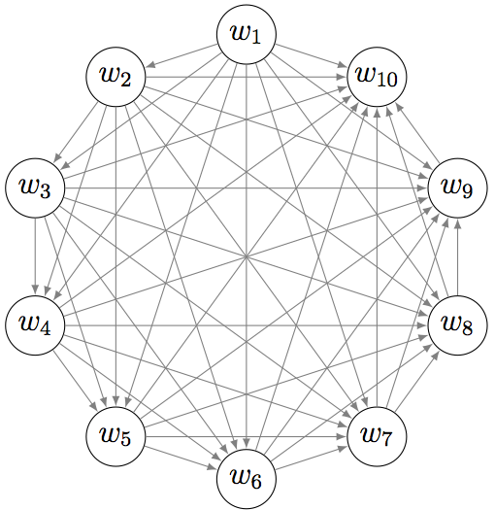
Methodology: Implementation
Topic Coherence
Measurement
Pairwise score
Optimal number of topics
Quality of top N words

Slide 11
Methodology: Evaluation
Topic Coherence: Automated Metrics
CV - Normalized Pointwise Mutual Information
UMass
UCI
Intrinsic metrics
Within Corpus
CV
Umass
Extrinsic metrics
External Corpus i.e. Wikipedia
UCI

Slide 12
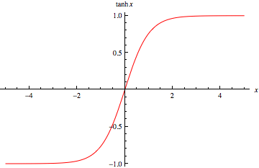
Methodology: Evaluation
Normalization
Tanh Function
Min-Max Scaling

Slide 13
Methodology: Evaluation
Human Judgement
5 People
Reliability Measurement
Krippendorff’s alpha value
Statistical calculation among multiple raters’ agreement
Alpha = 0.667
Alpha = 0.8

Slide 14
Methodology: Scope & Limitations
Scope
Data from HuffPost
Jupyter Notebook
Limitations
Wrong/Unavialable URLs
Different HTML Element Location

Slide 15
Results & Discussion

Slide 16
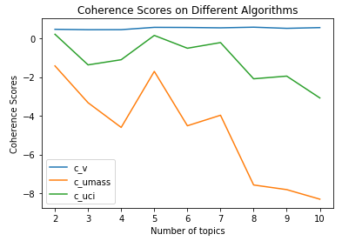
Results
Notes:
Without normalization

Slide 17
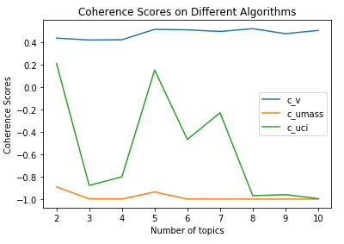
Results
Notes:
tanh

Slide 18
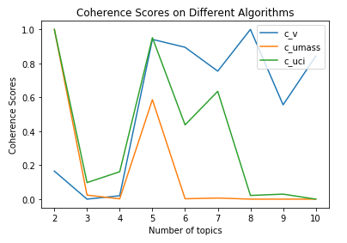
Results
Notes:
Tricky Number of Topics
Machine decision and Human Interaction
Model_0 (2 Topics) vs. Model_9 (10 Topics)

Slide 19
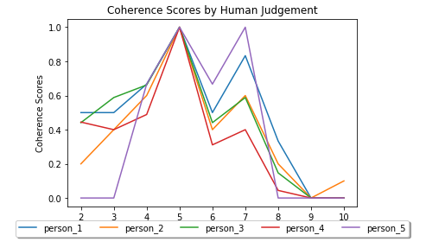
Results

Slide 20
Ranking | Topic | Number of Documents | Top 10 Words
1 | Topic_2 | 15,818 | ['election, president, state, country, vote, campaign, police, government, attack, official']
2 | Topic_4 | 11,188 | ['film, woman, video, love, star, movie, like, fan, host, actor']
3 | Topic_1 | 7,758 | ['company, percent, health_care, tax, million, climate_change, state, school, plan, woman']
4 | Topic_0 | 271 | ['investigation, email, intelligence, information, probe, campaign, special_counsel, committee, hacking, document']
5 | Topic_3 | 21 | ['percent, marijuana, margin_error, based_margin, survey, cannabis, model_based, assumption_wrong, survey_error, error_rest']

Slide 21
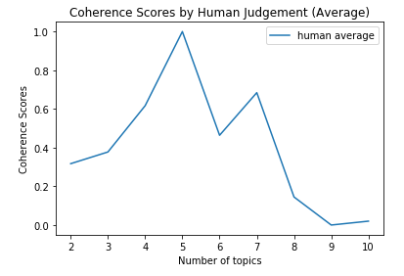
Results

Slide 22
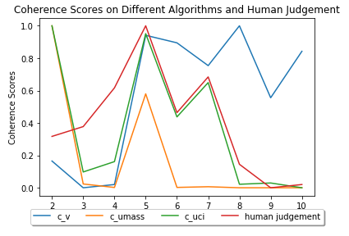
Results
Notes:
Model_3 (5 topics)
Human Judgement (9 Models)

Slide 23
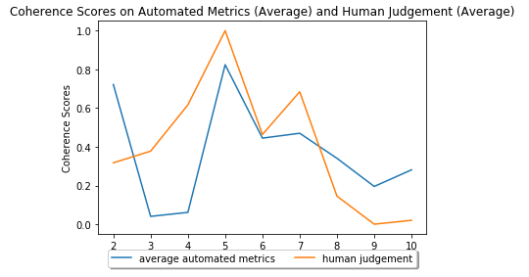
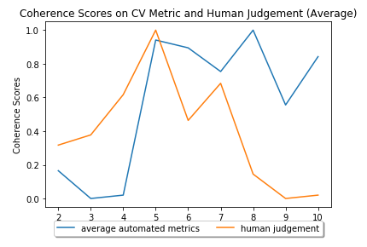
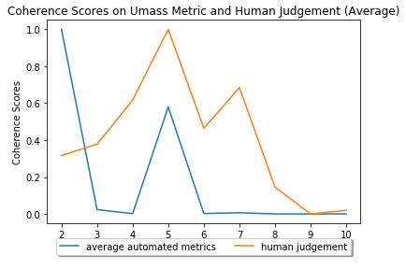
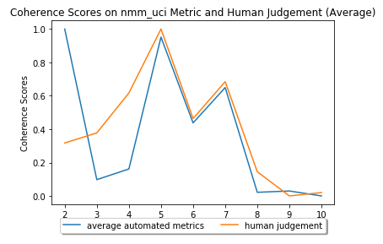
Results

Slide 24
Conclusion

Slide 25
Conclusion
Reducing human labor and time
Topic modeling
LDA: 9 models
Topic Coherence
Automated metrics
Human judgement
Normalization
Model_3 (5 topics)
UCI metric

Slide 26
Future Works

Slide 27
Future Works
More data
Spark or Hadoop
Different libraries/Tools
Removing proper nouns: Stanford Named Entity Recognizer (NER)
Finding categories: Wmatrix
Wordnet
Hypernym: ‘honeymoon’, ‘great_year’, ‘golden_age’, ‘half_life’
Hyponym: ‘time_period’
['gun', 'shooting', 'police', 'attack', 'killed', 'mass_shooting', 'gunman', 'firearm', 'suspect', 'gun_control'] → Entertainment

Slide 28
References
Blei, D. (2012). Probabilistic topic models. Communications of the ACM,55(4), 77-84.
Brysbaert, M. (2019). How many words do we read per minute? A review and meta-analysis of reading rate. Journal of Memory and Language, 109, Journal of Memory and Language, December 2019, Vol.109.
Gui, J., & Wang, Q. (2017). Topic modeling of news based on spark Mllib. 2017 14th International Computer Conference on Wavelet Active Media Technology and Information Processing (ICCWAMTIP), 2018, 224-228.
Krippendorff, K. (2004). Content analysis: An introduction to its methodology (2nd ed.).
Misra, R. (2018, May). News category dataset. ResearchGate.
Pleplé, Q. (2013, May). Topic coherence to evaluate topic models. Retrieved from http://qpleple.com/topic-coherence-to-evaluate-topic-models/

Slide 29
References
Pröllochs, N., & Feuerriegel, S. (2018). Business analytics for strategic management: Identifying and assessing corporate challenges via topic modeling. Information & Management, Information & Management.
Röder, M., Both, A., & Hinneburg, A. (2015). Exploring the Space of Topic Coherence Measures. Proceedings of the Eighth ACM International Conference on Web Search and Data Mining, 399-408.
Stevens, K., Kegelmeyer, P., Andrzejewski, D., & Buttler, D. Exploring Topic Coherence over Many Models and Many Topics. (2012, May). Proceedings of the 2012 Joint Conference on Empirical Methods in Natural Language Processing and Computational Natural Language Learning. 952–961.
Zhao, W., Zou, W., & Chen, J. (2014). Topic modeling for cluster analysis of large biological and medical datasets. BMC Bioinformatics, 15(Suppl 11), S11.

Slide 30
Thank You!

